Slide 1


Week 01

Slide 2
Welcome!
Course Expectations
Syllabus review
Tour Pilot
Tour Discord
Tour GitHub
Tour Resources
Academic retention
Note:
Slides change throughout week - download after Thursday

Slide 3
How to Write an Email
"HELP!!!!" Is not a good email title
Start with class title:
CEG 2350 OR OS Concepts
Add topic:
CEG 2350: Lab 04 Regex
Email body should be details, how to recreate, and your understanding of the problem

Slide 4
Programs to have
WSL2 (Windows users)
Terminal manager?
Visual Studio Code
Material Icon Theme, Prettier, Source Control / git (I “cheat” and tell GitHub Desktop to open in VSCode)
Git
GitHub Desktop (useful, but needed here)
https://github.com/pattonsgirl/Fall2021-CEG2350/blob/main/EnvironmentSetup.md
Invite to AWS Educate coming soon

Slide 5
Final Question:
Does anyone present go by “Bob”?
I pick on “Bob” a lot

Slide 6
Computer Basics

Slide 7
History of Computers
https://people.cs.rutgers.edu/~pxk/416/notes/01-intro.html
Long but an very educational read
What to know:
We’ve come a long way
A lot of research teams worked on different elements over time
Some focused on access for academics - free only to universities
Unix born
Others went for private sector - Windows & Mac
Companies came out with all sort of architecture - OSes we made to match

Slide 8
Composition of a computer
Hardware
PC parts – CPU, RAM, motherboard, graphics, hard drives, power supply
Software
Kernel, OS, applications
Firmware
BIOS (Basic Input Output System)
Motherboard
Notes:
Plugging for my favorite chain: Microcenter

Slide 9
The Big Three
Windows
Windows NT kernel
Windows NT, 2000, XP, Vista, 7, 8, 8.1 and 10
Mac
XNU (X not Unix)
Apple TV Software, iOS, iPadOS, watchOS, and tvOS OSes
Linux / Unix
Linux and Unix have separate kernels that OSes sit on top of
Ubuntu, Debian, RedHat, Gentoo, Android…
The named OSes = distributions
Notes:
https://distrowatch.com/

Slide 10
How do you work with computers?
Kernel – core of Operating System
Facilitates interactions between hardware and software
OS sits between user and hardware (+ system security & protection)

Slide 11
Pick up here

Slide 12
Note on Software Requirements
WSL2 is no longer /required/
It is still cool
We will still talk about it with respect to VMs and filesystems
Ubuntu 20.04
Mobaxterm + cygutils add on package is plenty for windows users

Slide 13
Homework & Lab Expectations
How to be ready for Lab 01 next week
Lab session details
Live here in Oelman 320, can attend via Webex, session will be recorded
Get your environment set up
Create GitHub account
Register for AWS Educate (link in email)
Beware graduation date
Beware promo code field
If you don’t have access to these things email me

Slide 14
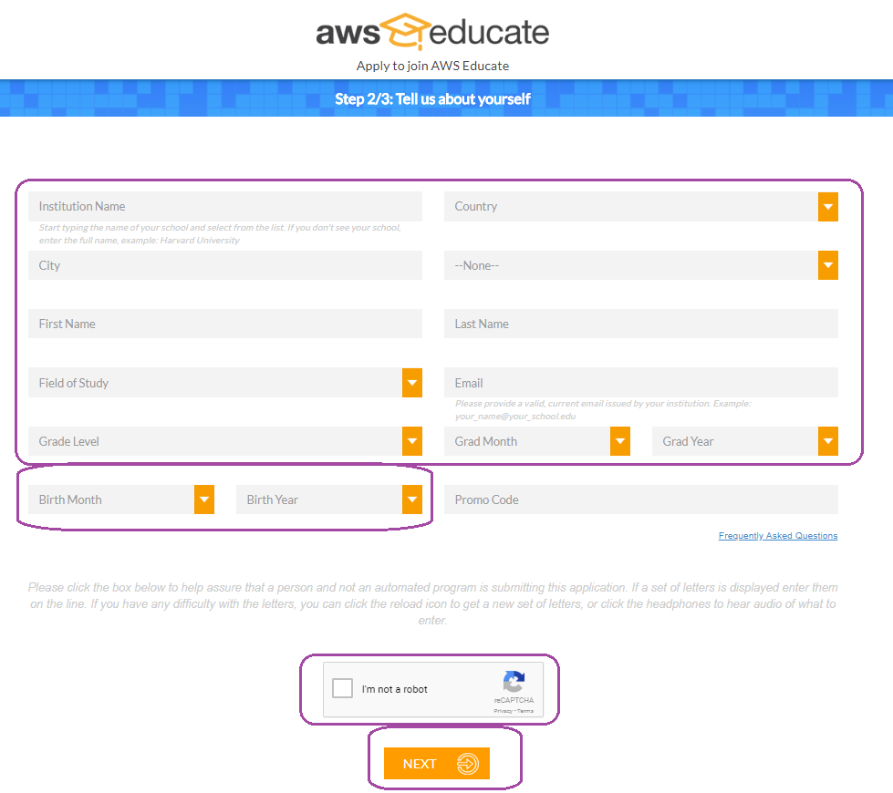

Slide 15
Introducing the Terminal

Slide 16
Common Shells
Shells are programs with programming languages of their own
Aka. Command interpreter
Bash
Powershell
Others:
Zsh, tcsh, dash, sh, cmd.exe
https://en.wikipedia.org/wiki/Comparison_of_command_shells

Slide 17
Know your place
The lines of a terminal have important info that usually includes:
name@system:~/folder$
Who you are signed in as
name@
The name of the system
@system
The folder you are in (sometimes)
~/folder
The user mode you are using (sometimes)
$ vs #

Slide 18
You got to read it read it
Commands that you run will likely do one of three things:
Succeed quietly
Succeed and move to the next step / ask for more info
Error and give you a message
The errors should be read carefully
9 times out of 10, the errors tell you why the command couldn’t run

Slide 19
Built-ins vs Programs
“help” – lists the built-in shell functions / commands
Test help in cmd, bash, and Powershell
“man” – the Linux Manual Pages
Manual for everything not in “help”
“man” == “help” in Powershell
Notes:
Of the two – man and help, remember man. Tuck help in your brain for when your computer flips its lid and the only thing that loads is the kernel

Slide 20
Basic Linux Commands
$ man – Manual pages for a command
$ history – Lists of all commands ever typed into terminal
$ vim – Text editor (works with no mouse)
$ ls - List files
$ pwd - Print out the current directory paths
$ cd - Change directories
$ cat - read a file
Did something you don’t like? Try Ctrl + C

Slide 21
Vim basics
$ vim filename
Opens file in vim
Escape key (Esc) let’s you give vim commands
i = insert mode
You can edit text. Arrow keys to move around in the file
(Esc) :w - saves changes
(Esc) :q - quits the vim editor
(Esc) :wq - saves changes and exits (so does :x)
(Esc) :q! - emergency exit, no changes saved
This is my go to, “Did I type something wrong in this config file?” option

Slide 22
Command Line Flags & Parameters
Example: ls –lah
-l = list
-a = all
-h = human readable
How do we find the flag options for cd?

Slide 23
Common Windows Commands
> help - prints out guides when paired with a command
> cd - changes directory
> dir - lists contents of a directory
Edit files?
Download vim for Windows
Download nano for Windows
> notepad filename

Slide 24
Hidden Files / Folders
Run commands (or run control) files in shells
Per user – think of these as environment configuration files
.bashrc, .vimrc
Hidden stuff in Windows

Slide 25
Intro to SSH

Slide 26
SSH Basics
SSH = Secure Shell
Using SSH connections, we can get terminal access to a computer
No GUIs / graphical interfaces. Just you and the blinking line
Most SSH connections require at minimum:
The username you want to sign in as on the other system
Some identifier for the computer - IP address or hostname
$ ssh ubuntu@123.123.123.123

Slide 27
Intro to SSH Keys

Slide 28
Intro to SSH Keys
SSH is an authentication method that uses a public and private key pair
To ssh to a system is to create a secure connection tunnel to that system
Private keys
You will get one of these when you create your AWS key pair
Private keys are for you only. Think social security of authentication
Public keys
Go on the system you are connecting to

Slide 29
Intro to git & GitHub

Slide 30
Setting up GitHub
Create a key pair
Do this for each system you want to hook to GitHub
Find the public key of that pair
look at your output from making your key
Boom. Done.
“git”, the program, knows how to find the private key (if you left the defaults alone) and will check with GitHub to use the public key you gave it

Slide 31
Intro to Git
Version management software
Savior of programmers / developers
GitHub is a server / host of repositories
Git is a program / command for version management
Notes:
https://docs.github.com/en/github/authenticating-to-github/generating-a-new-ssh-key-and-adding-it-to-the-ssh-agent

Slide 32
Git config commands
$ git config --global user.name "John Doe"
$ git config --global user.email johndoe@example.com

Slide 33
Basic git commands
git clone URL
uses URL & sets up connection back to GitHub
git add files/folders
add files to be tracked (if they are new)
git commit
Commits are like checkpoints. You write a note of what changes happened. Only the changes of files are captured in a commit
git push
pushes commits (think record of latest changes) to GitHub

